Slide 1
Controlling Traveling-Wave Phonons at Room Temperature
Joel N. Johnson
April 25th, 2025
Northern Arizona University

Slide 2
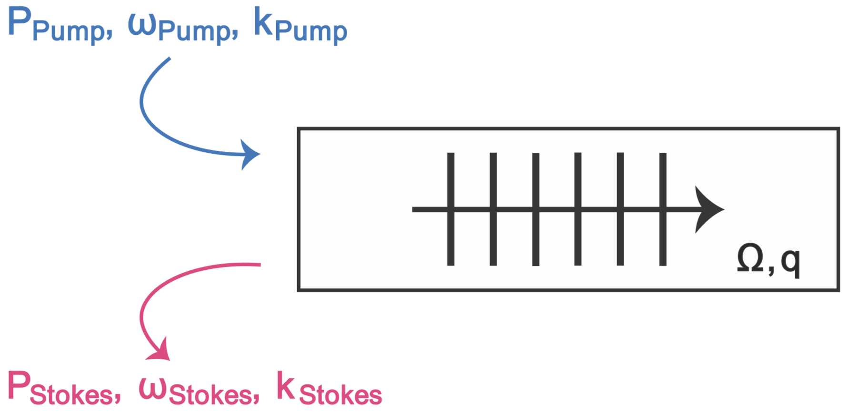
Brillouin Scattering: Optomechanical Coupling

Slide 3
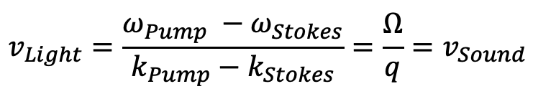
Brillouin Scattering: Optomechanical Coupling
Phase (velocity) matching:
$$v_{Light}=\frac{ω_{Pump} −ω_{Stokes}}{k_{Pump}−k_{Stokes}}=\frac{Ω}{q}=v_{Sound}$$

Slide 4
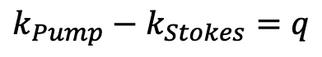
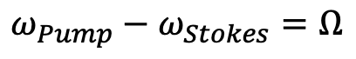
Brillouin Scattering: Optomechanical Coupling
Phase (velocity) matching:
$$v_{Light}=\frac{ω_{Pump} −ω_{Stokes}}{k_{Pump}−k_{Stokes}}=\frac{Ω}{q}=v_{Sound}$$
✓
Energy Conservation:
$$ω_{Pump}−ω_{Stokes}=Ω$$
✓
Momentum Conservation:
$$k_{Pump}−k_{Stokes}=q$$

Slide 5
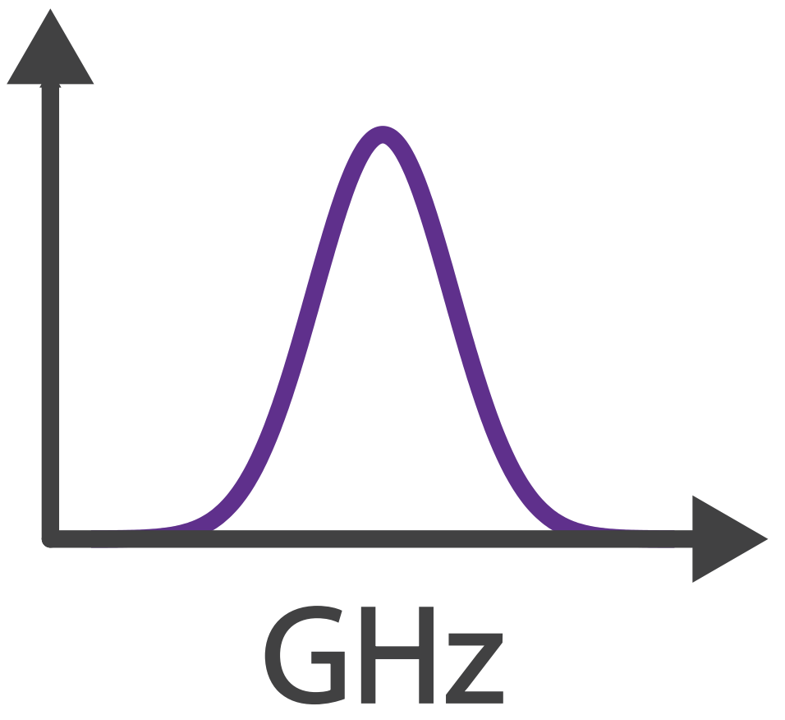

Brillouin Scattering: Optomechanical Coupling
Phase (velocity) matching:
$$v_{Light}=\frac{ω_{Pump} −ω_{Stokes}}{k_{Pump}−k_{Stokes}}=\frac{Ω}{q}=v_{Sound}$$
✓
Energy Conservation:
$$ω_{Pump}−ω_{Stokes}=Ω$$
✓
Momentum Conservation:
$$k_{Pump}−k_{Stokes}=q$$
$$Ω$$

Slide 6
Controlling Sound with Light
Laser Cooling of Traveling-Wave Phonons in an Optical Fiber
Quieting sound with light

Slide 7
Controlling Sound with Light
Laser Cooling of Traveling-Wave Phonons in an Optical Fiber
Quieting sound with light
Coherently stimulated Brillouin Scattering (CoBS)
Amplifying sound to measure subtle signals

Slide 8
Controlling Sound with Light
Laser Cooling of Traveling-Wave Phonons in an Optical Fiber
Quieting sound with light
Coherently stimulated Brillouin Scattering (CoBS)
Amplifying sound to measure subtle signals
Brillouin-Induced Raman Modes
Harnessing sound for engineered behaviors

Slide 9
Laser Cooling
Why do we care about laser cooling?
Reduce thermal noise
Access quantum regimes

Slide 10
Laser Cooling
Why do we care about laser cooling?
Reduce thermal noise
Access quantum regimes
Demonstrated for discrete cavity systems
Resonant cavities permit discrete modes
Tune laser just red of cavity resonance → discrete mode cooling

Slide 11
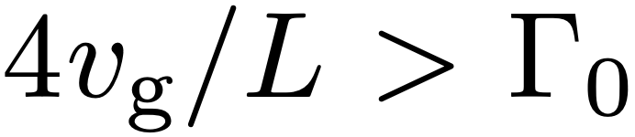
Laser Cooling of a Continuum of Modes
Fast escape condition
Remove phonons faster than they are replenished:

Slide 12
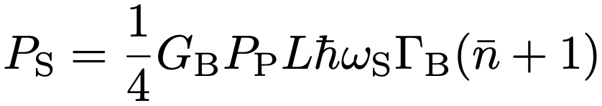
Laser Cooling of a Continuum of Modes
Fast escape condition
Remove phonons faster than they are replenished:
Challenging because scattered power scales with length:

Slide 13
Laser Cooling of a Continuum of Modes
Fast escape condition
Remove phonons faster than they are replenished:
Challenging because scattered power scales with length:
Gain
Power
Thermal

Slide 14
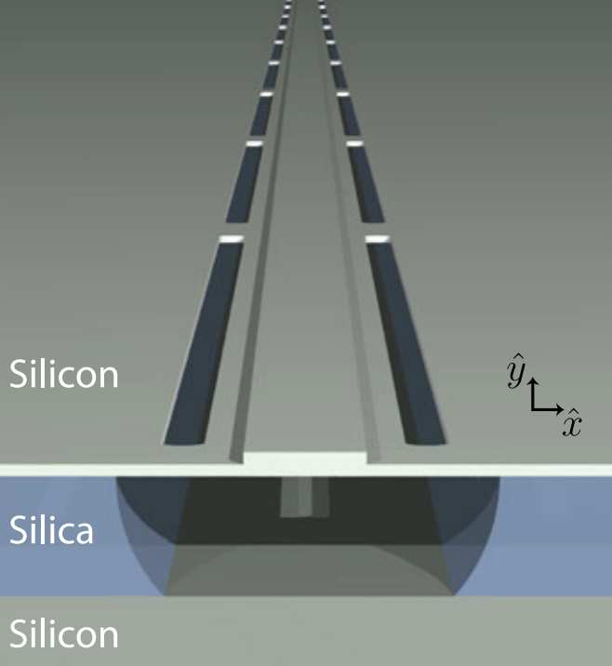
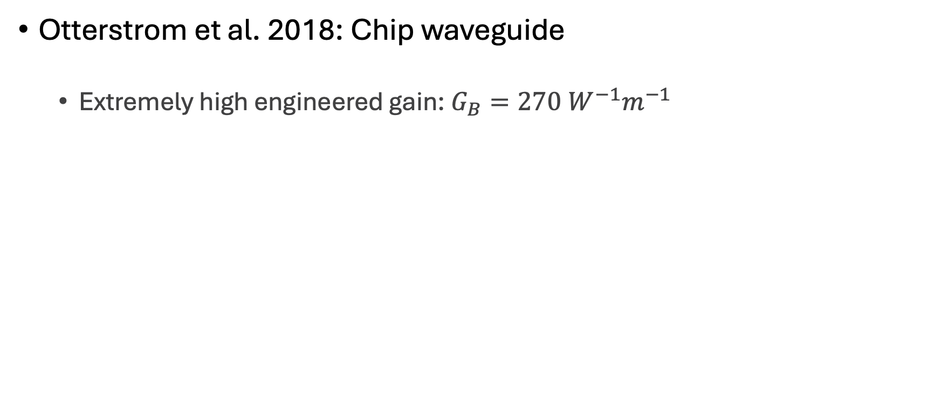
Laser Cooling of a Continuum of Modes
Otterstrom et al. 2018: Chip waveguide
Extremely high engineered gain: $G_{B}=270 W^{−1}m^{−1}$

Slide 15
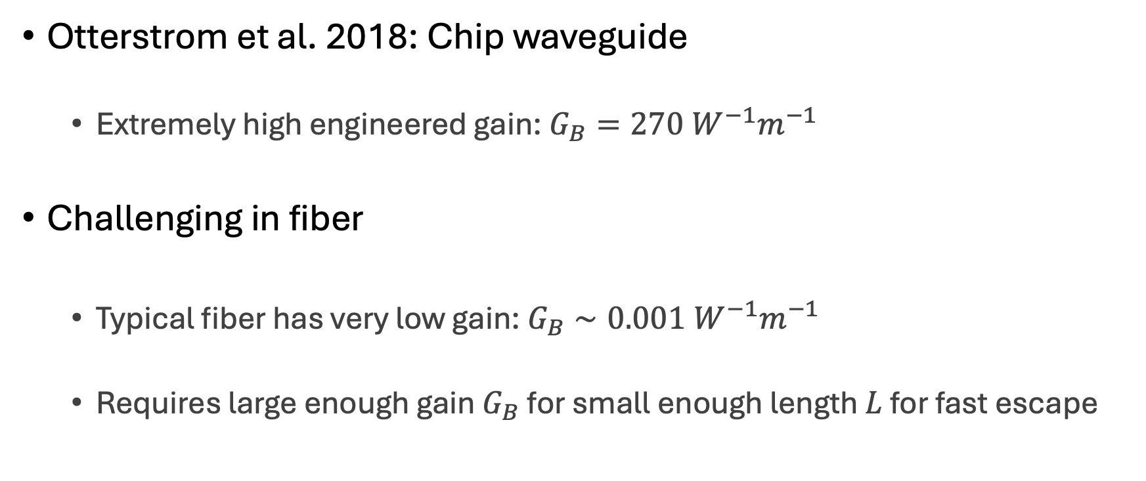
Laser Cooling of a Continuum of Modes
Otterstrom et al. 2018: Chip waveguide
Extremely high engineered gain: $G_{B}=270 W^{−1}m^{−1}$
Challenging in fiber
Typical fiber has very low gain: $G_{B}∼0.001 W^{−1}m^{−1}$
Requires large enough gain $G_{B}$ for small enough length $L$ for fast escape

Slide 16
Optomechanical Cooling
Material at room temperature has thermal fluctuations (phonons)
Ω
phonon

Slide 17
Optomechanical Cooling
Material at room temperature has thermal fluctuations (phonons)
Laser light
Ω
⍵_{P}
phonon

Slide 18
Optomechanical Cooling
Material at room temperature has thermal fluctuations (phonons)
Laser light backscatters off approaching sound wave (Brillouin scattering)
Ω
⍵_{P}
phonon

Slide 19
Optomechanical Cooling
Material at room temperature has thermal fluctuations (phonons)
Laser light backscatters off approaching sound wave (Brillouin scattering)
Energy transfers from sound to light:
Returning light is frequency upshifted (blue-shifted)
⍵_{aS} = ⍵_{P} + Ω
Ω
⍵_{P}
phonon

Slide 20
Optomechanical Cooling
Material at room temperature has thermal fluctuations (phonons)
Laser light backscatters off approaching sound wave (Brillouin scattering)
Energy transfers from sound to light:
Returning light is frequency upshifted (blue-shifted)
Sound wave intensity is lowered (cooled)
⍵_{aS} = ⍵_{P} + Ω
Ω
⍵_{P}
phonon

Slide 21
Optomechanical Cooling
Material at room temperature has thermal fluctuations (phonons)
Laser light backscatters off approaching sound wave (Brillouin scattering)
Energy transfers from sound to light:
Returning light is frequency upshifted (blue-shifted)
Sound wave intensity is lowered (cooled)
⍵_{aS} = ⍵_{P} + Ω
Ω
⍵_{P}
phonon

Slide 22
Optomechanical Cooling
Material at room temperature has thermal fluctuations (phonons)
Laser light backscatters off approaching sound wave (Brillouin scattering)
Energy transfers from sound to light:
Returning light is frequency upshifted (blue-shifted)
Sound wave intensity is lowered (cooled)
anti-Stokes
⍵_{aS} = ⍵_{P} + Ω
Ω
⍵_{P}
phonon

Slide 23
Solution: CS₂
Carbon disulfide (CS₂) is a very high gain liquid

Slide 24
Solution: CS₂-Filled Liquid-Core Optical Fiber
Carbon disulfide (CS₂) is a very high gain liquid
Fill hollow-core optical fiber with CS₂:
1 meter
SMF-28
UHNA7
hollow-core
UHNA7
SMF-28
~1.68 µm

Slide 25
Solution: CS₂-Filled Liquid-Core Optical Fiber
Carbon disulfide (CS₂) is a very high gain liquid
Fill hollow-core optical fiber with CS₂:
1 meter
SMF-28
UHNA7
hollow-core
UHNA7
SMF-28
~1.68 µm

Slide 26
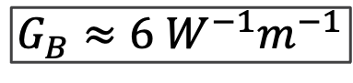
Solution: CS₂-Filled Liquid-Core Optical Fiber
Carbon disulfide (CS₂) is a very high gain liquid
Fill hollow-core optical fiber with CS₂:
1 meter
SMF-28
UHNA7
hollow-core
UHNA7
SMF-28
~1.68 µm
$$G_{B}≈6 W^{−1}m^{−1}$$

Slide 27
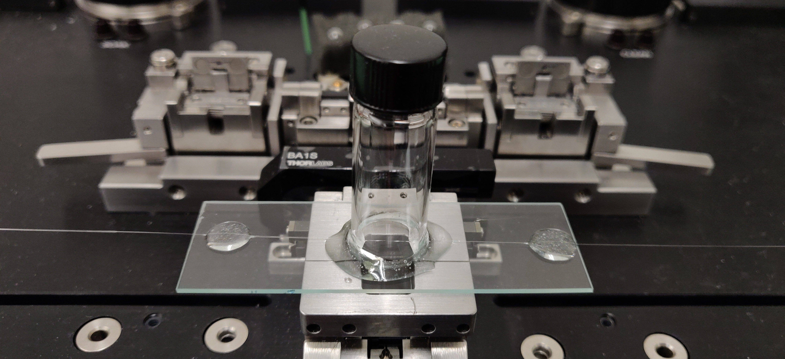
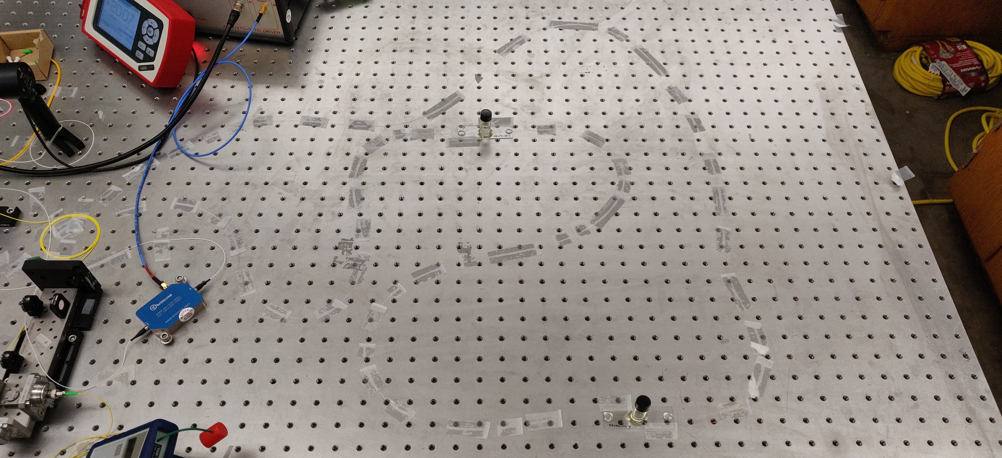
Liquid-core Optical Fiber Sample

Slide 28
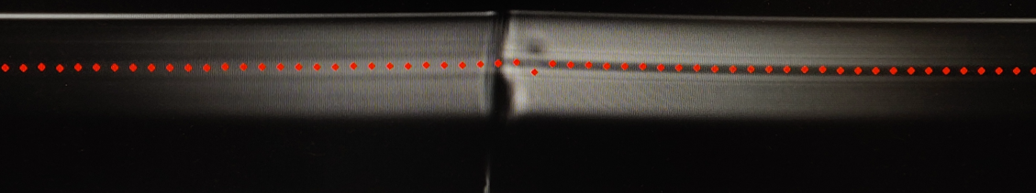
Liquid-core Optical Fiber Sample

Slide 29
Liquid-core Optical Fiber Sample
CS₂ enters here

Slide 30

Liquid-core Optical Fiber Sample
CS₂ enters here

Slide 31
Cooling Figure of Merit
All materials have a natural rate of mechanical dissipation (Γ₀)

Slide 32
Cooling Figure of Merit
All materials have a natural rate of mechanical dissipation (Γ₀)
To cool is to increase dissipation rate (Γ₊)

Slide 33
Cooling Figure of Merit
All materials have a natural rate of mechanical dissipation (Γ₀)
To cool is to increase dissipation rate (Γ₊)
Spectral linewidth gives dissipation rate
Γ

Slide 34
Cooling Figure of Merit
All materials have a natural rate of mechanical dissipation (Γ₀)
To cool is to increase dissipation rate (Γ₊)
Spectral linewidth gives dissipation rate
Broadened linewidth gives measure of cooling
Γ

Slide 35
Cooling Figure of Merit
Broadened linewidth gives measure of cooling

Slide 36
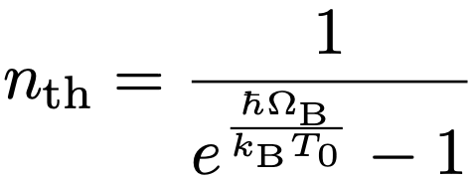
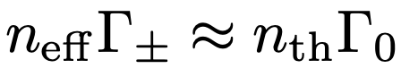
Cooling Figure of Merit
Broadened linewidth gives measure of cooling:

Slide 37
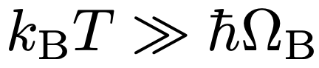
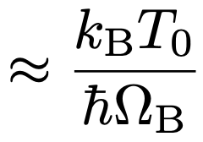
Cooling Figure of Merit
Broadened linewidth gives measure of cooling:

Slide 38
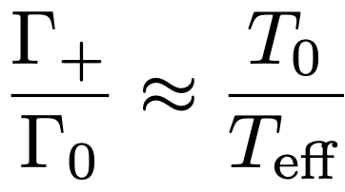
Cooling Figure of Merit
Broadened linewidth gives measure of cooling:

Slide 39
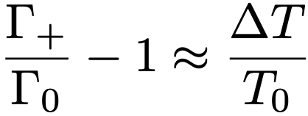
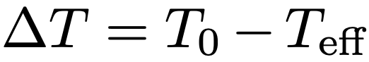
Cooling Figure of Merit
Broadened linewidth gives measure of cooling:

Slide 40
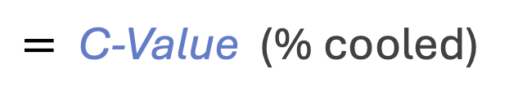
Cooling Figure of Merit
Broadened linewidth gives measure of cooling:
$=$ C-Value (% cooled)

Slide 41
Experimental Setup

Slide 42
Results
Γ

Slide 43
Results
Γ

Slide 44
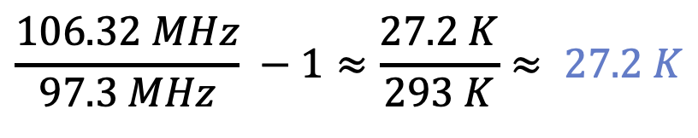
Results
Γ
$$\frac{106.32 MHz}{97.3 MHz} −1≈\frac{27.2 K}{293 K}≈ 27.2 K$$
cooling from room temperature

Slide 45
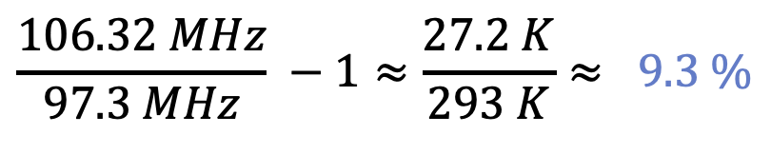
Results
Γ
$$\frac{106.32 MHz}{97.3 MHz} −1≈\frac{27.2 K}{293 K}≈ 9.3 \%$$
C-Value

Slide 46
Controlling Sound with Light
Laser Cooling of Traveling-Wave Phonons in an Optical Fiber
Quieting sound with light
Coherently stimulated Brillouin Scattering (CoBS)
Amplifying sound to measure subtle signals

Slide 47
Controlling Sound with Light
Laser Cooling of Traveling-Wave Phonons in an Optical Fiber
Quieting sound with light
Coherently stimulated Brillouin Scattering (CoBS)
Amplifying sound to measure subtle signals

Slide 48
Brillouin Spectroscopy
What is Brillouin spectroscopy?
Measurement of mechanical properties of materials
Obtain mechanical resonances, elastic moduli

Slide 49
Brillouin Spectroscopy
What is Brillouin spectroscopy?
Measurement of mechanical properties of materials
Obtain mechanical resonances, elastic moduli
Where is it used?
Biomechanics and medical diagnostics
Distributed fiber-optic strain and temperature monitoring along structures

Slide 50
Traditional Brillouin Scattering
Spontaneous Brillouin scattering
Thermal phonons

Slide 51
Traditional Brillouin Scattering
Spontaneous Brillouin scattering
Thermal phonons
Stimulated Brillouin scattering
Inject Stokes seed
Self-reinforcing process

Slide 52
Traditional Brillouin Scattering
Would be nice to drive with Stokes
Problem: drowns the signal

Slide 53
Coherently Stimulated Brillouin Scattering?
Would be nice to drive with Stokes
Problem: drowns the signal
Separate, shifted probe laser?
Incoherent with driven phonon mode
Would not “talk” to the driven phonons (unphase-matched)

Slide 54
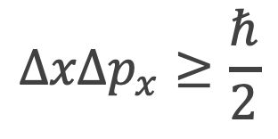
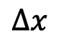
Phase Matching Relaxation
At small scales, position certainty means momentum uncertainty
$$ΔxΔp_{x}≥\frac{ℏ}{2}$$
Heisenberg uncertainty principle
$$Δx$$

Slide 55
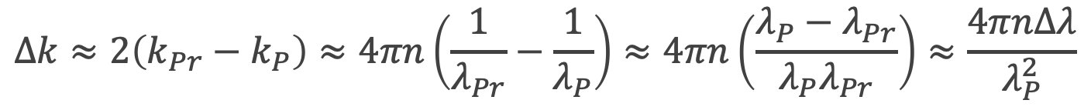
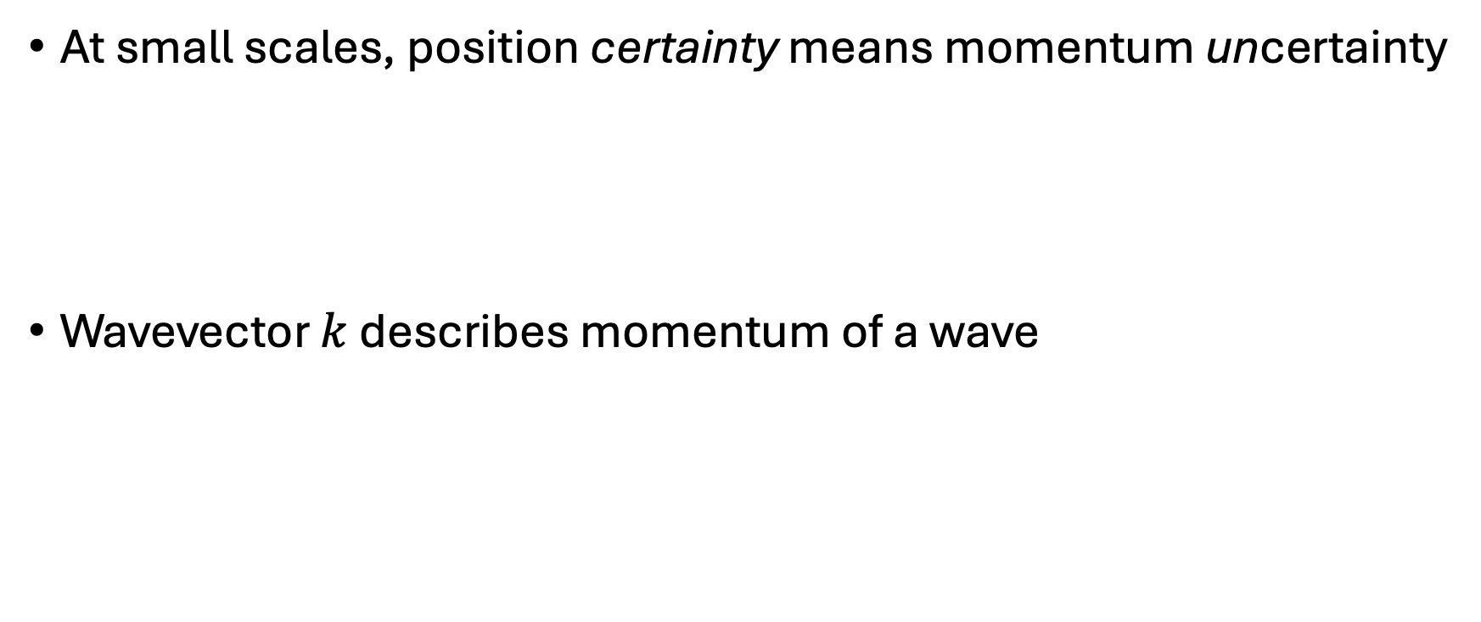
Phase Matching Relaxation
At small scales, position certainty means momentum uncertainty
Wavevector $k$ describes momentum of a wave
$$ΔxΔp_{x}≥\frac{ℏ}{2}$$
$$Δk≈2\left(k_{Pr}−k_{P}\right)≈4πn\left(\frac{1}{λ_{Pr}}−\frac{1}{λ_{P}}\right)≈4πn\left(\frac{λ_{P}−λ_{Pr}}{λ_{P}λ_{Pr}}\right)≈\frac{4πnΔλ}{λ_{P}^{2}}$$

Slide 56
Phase Matching Relaxation
At small scales, position certainty means momentum uncertainty
Wavevector $k$ describes momentum of a wave
$$ΔxΔp_{x}≥\frac{ℏ}{2}$$
Pump-probe detuning
$$Δk≈2\left(k_{Pr}−k_{P}\right)≈4πn\left(\frac{1}{λ_{Pr}}−\frac{1}{λ_{P}}\right)≈4πn\left(\frac{λ_{P}−λ_{Pr}}{λ_{P}λ_{Pr}}\right)≈\frac{4πnΔλ}{λ_{P}^{2}}$$

Slide 57
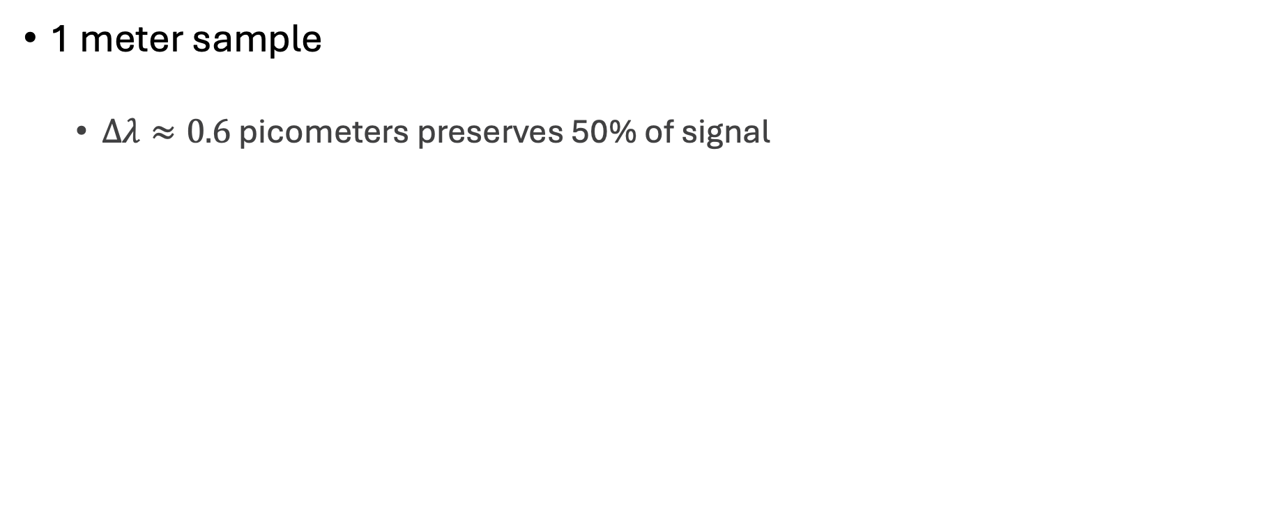
Cheating Phase Matching
1 meter sample
$Δλ≈0.6$ picometers preserves 50% of signal

Slide 58
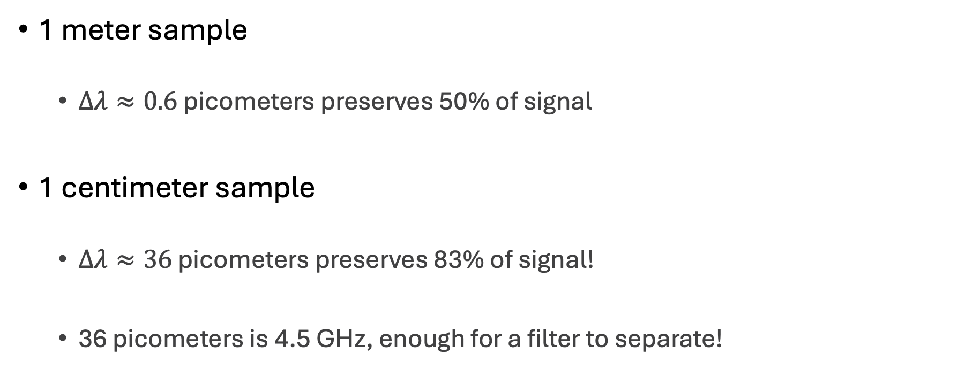
Cheating Phase Matching
1 meter sample
$Δλ≈0.6$ picometers preserves 50% of signal
1 centimeter sample
$Δλ≈36$ picometers preserves 83% of signal!
36 picometers is 4.5 GHz, enough for a filter to separate!

Slide 59
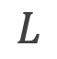
Coherently Stimulated Brillouin Spectroscopy
Allows Stokes driving while preserving coherence with a shifted probe
$$L$$

Slide 60
Coherently Stimulated Brillouin Spectroscopy
Allows Stokes driving while preserving coherence with a shifted probe
~1 million times more powerful than traditional SBS!
$$L$$

Slide 61
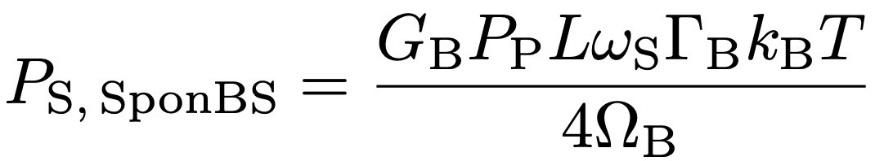
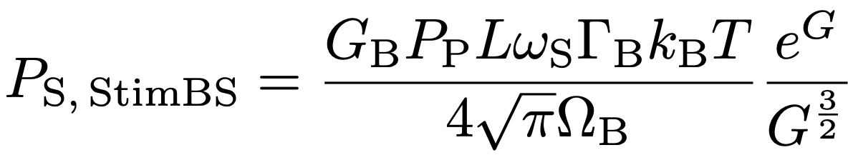
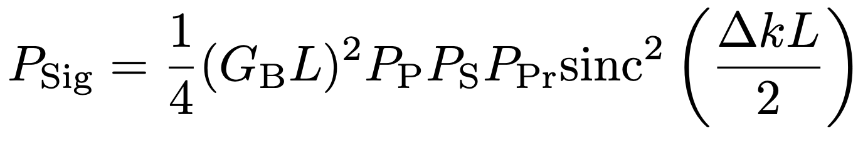
CoBS vs StimBS vs SponBS
Spontaneous BS
Stimulated BS
CoBS

Slide 62
CoBS vs StimBS vs SponBS

Slide 63
CoBS:

Slide 64
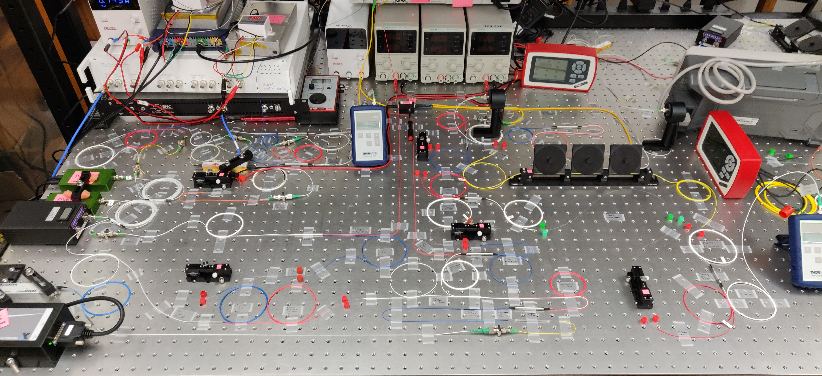
CoBS:

Slide 65
Controlling Sound with Light
Laser Cooling of Traveling-Wave Phonons in an Optical Fiber
Quieting sound with light
Coherently stimulated Brillouin Scattering (CoBS)
Amplifying sound to measure subtle signals
Brillouin-Induced Raman Modes
Harnessing sound for engineered behaviors

Slide 66
Controlling Sound with Light
Laser Cooling of Traveling-Wave Phonons in an Optical Fiber
Quieting sound with light
Coherently stimulated Brillouin Scattering (CoBS)
Amplifying sound to measure subtle signals
Brillouin-Induced Raman Modes
Harnessing sound for engineered behaviors

Slide 67
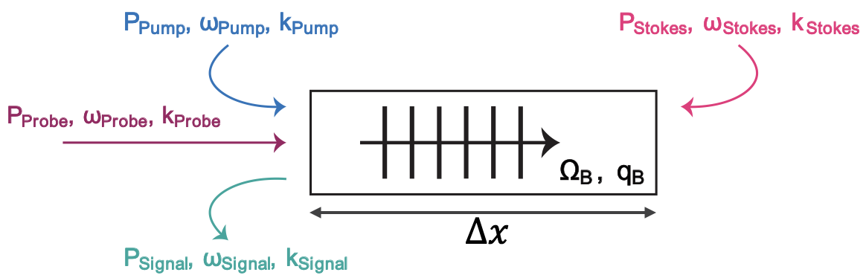
Explore Brillouin/Raman Transition
Brillouin
Travelling-wave phonons in bulk material
CoBS
Travelling Wave Phonons

Slide 68
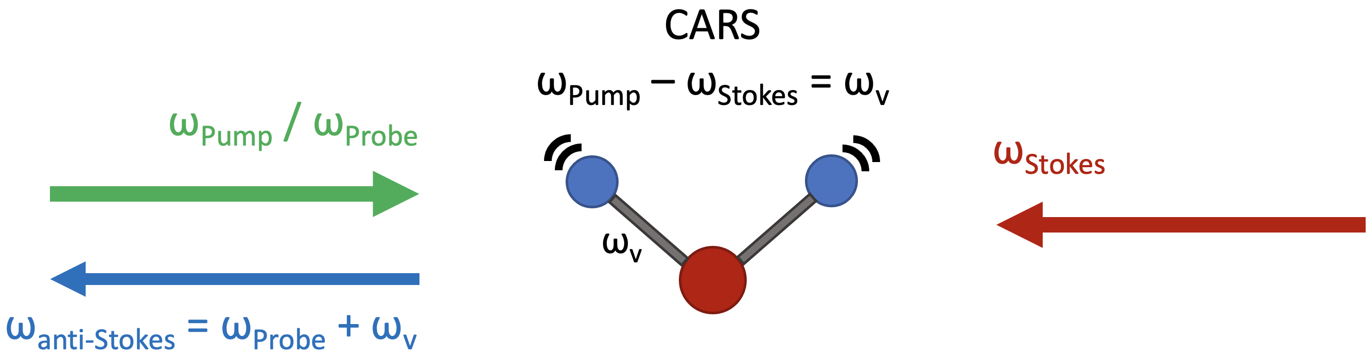
Explore Brillouin/Raman Transition
Brillouin
Travelling-wave phonons in bulk material
Raman
Standing wave phonons in molecular vibrations
CoBS
Travelling Wave Phonons
Standing Wave Phonons

Slide 69
Explore Brillouin/Raman Transition
Brillouin
Travelling-wave phonons in bulk material
Raman
Standing wave phonons in molecular vibrations
Start in Brillouin domain and approach Raman-like modes
CoBS
Travelling Wave Phonons
Standing Wave Phonons

Slide 70
Reflected Phonons Create Standing Waves
Ω
Ω

Slide 71
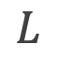
In-Phase Phonons Constructively Interfere
$$L$$
Ω
Ω

Slide 72
In-Phase Phonons Constructively Interfere
$$L$$
Ω
Ω

Slide 73
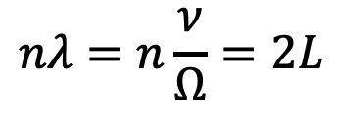
In-Phase Phonons Constructively Interfere
$$nλ=n\frac{ν}{Ω}=2L$$
$$L$$
Ω
Ω

Slide 74
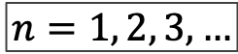
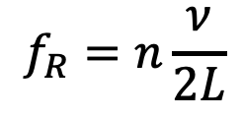
In-Phase Phonons Constructively Interfere
$$nλ=n\frac{ν}{Ω}=2L$$
$$L$$
$$f_{R}=n\frac{ν}{2L}$$
$$n=1, 2, 3, …$$
Ω
Ω

Slide 75
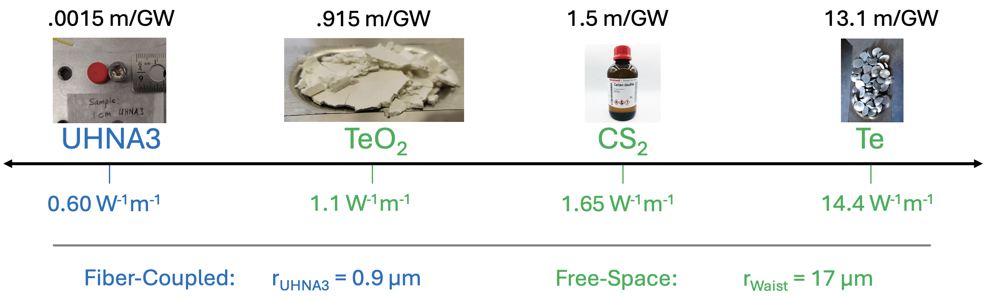
Gain of Relevant Materials

Slide 76
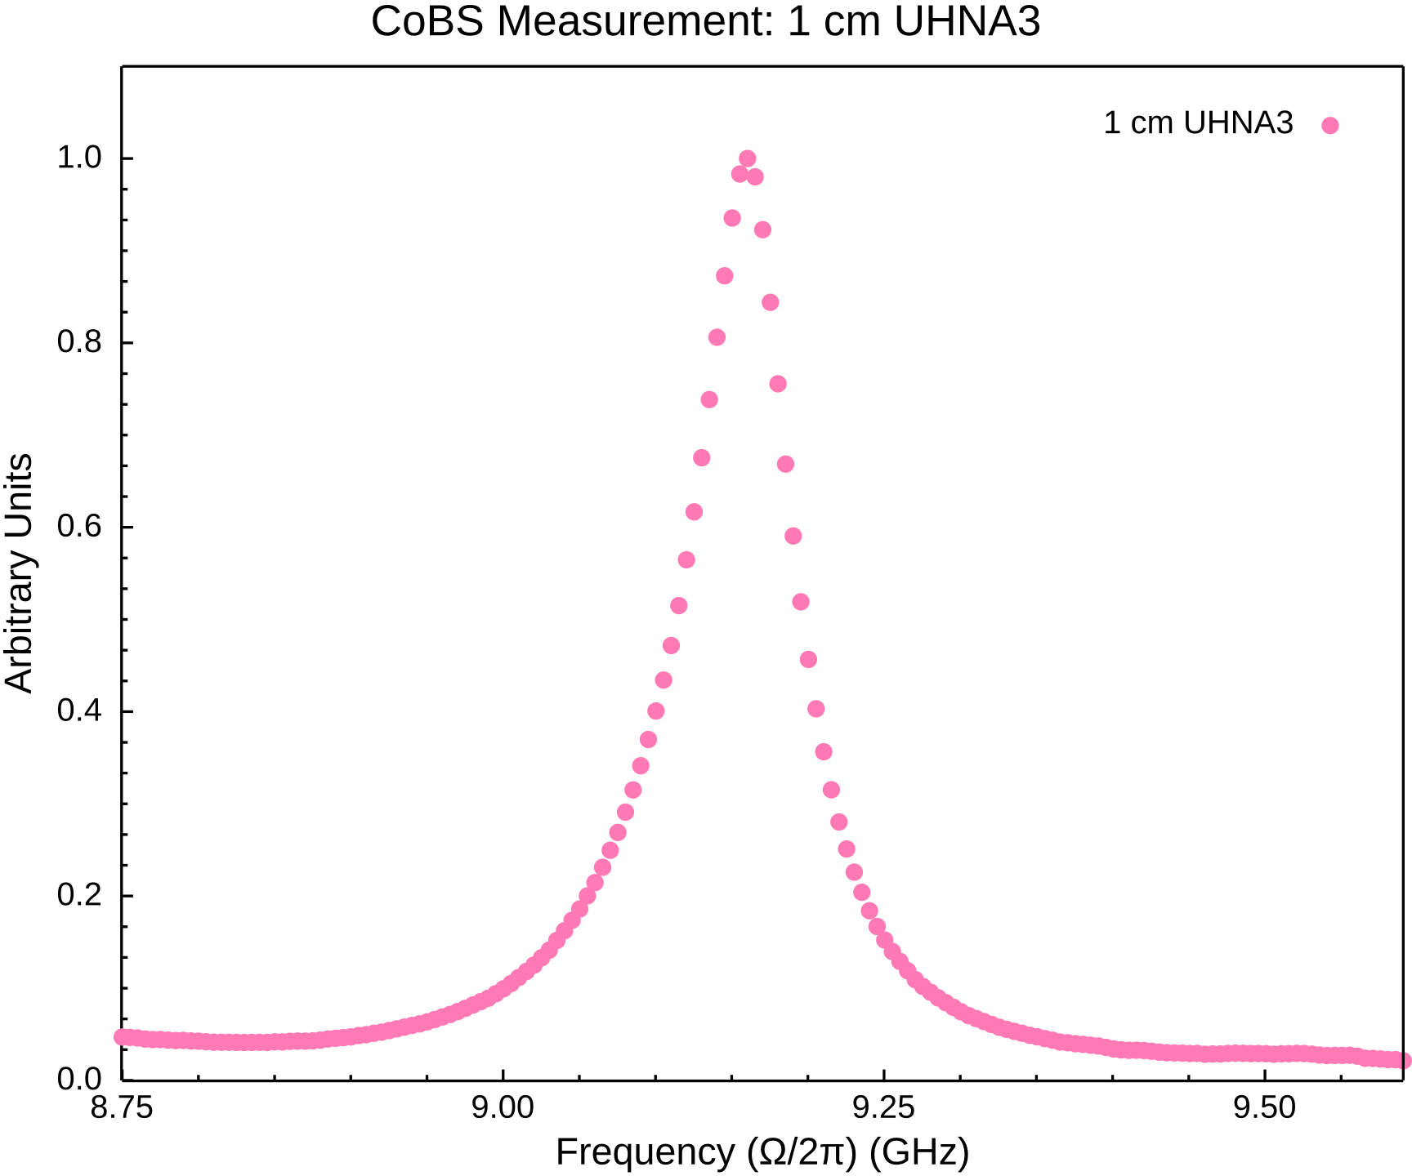
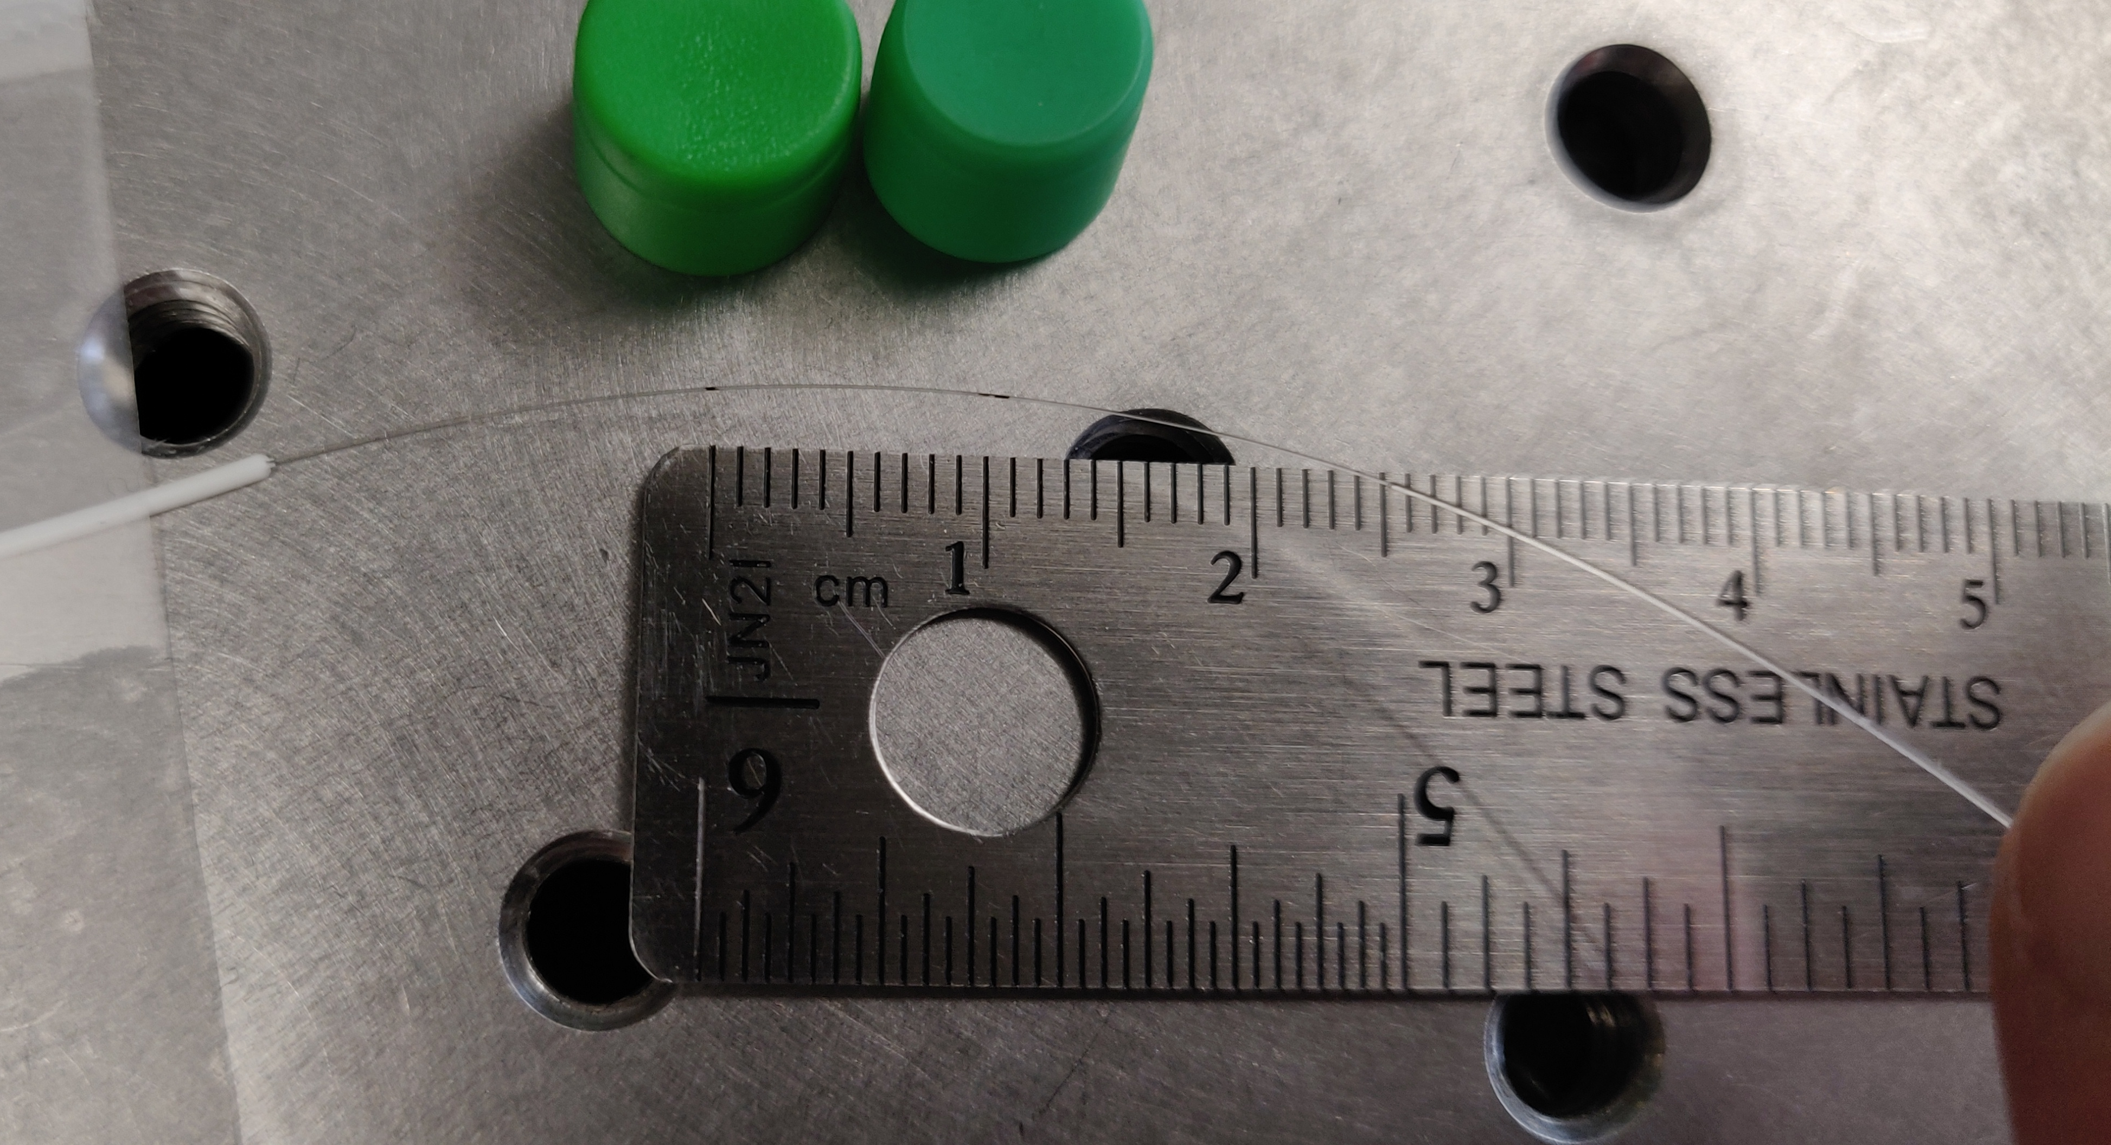
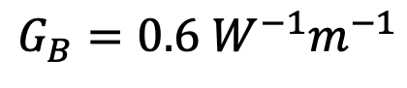
1 cm Germanium-Doped Fiber
$$G_{B}=0.6 W^{−1}m^{−1}$$

Slide 77
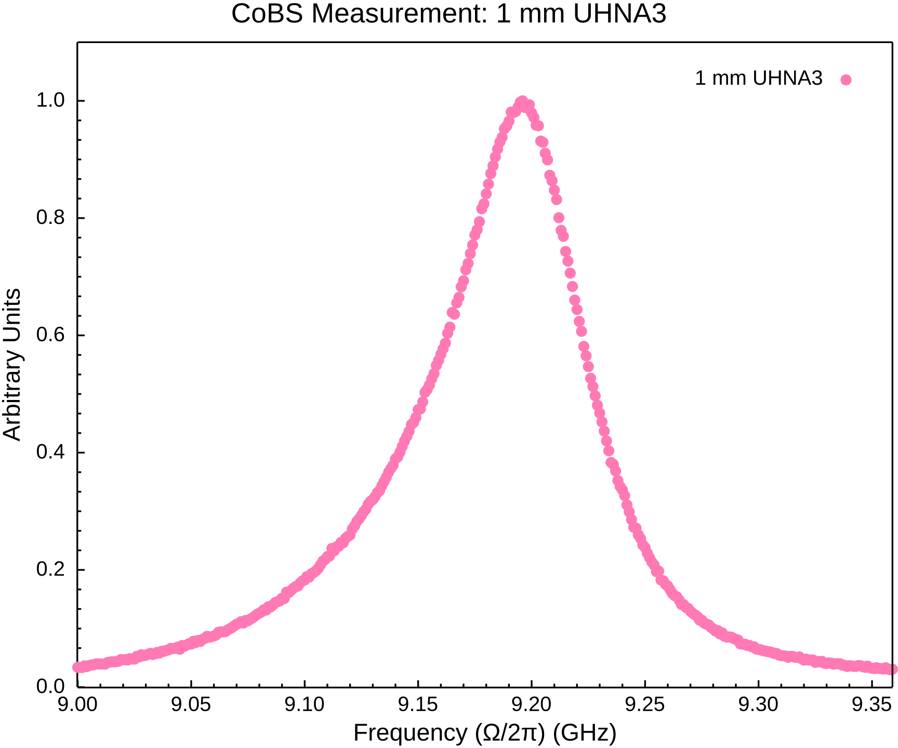
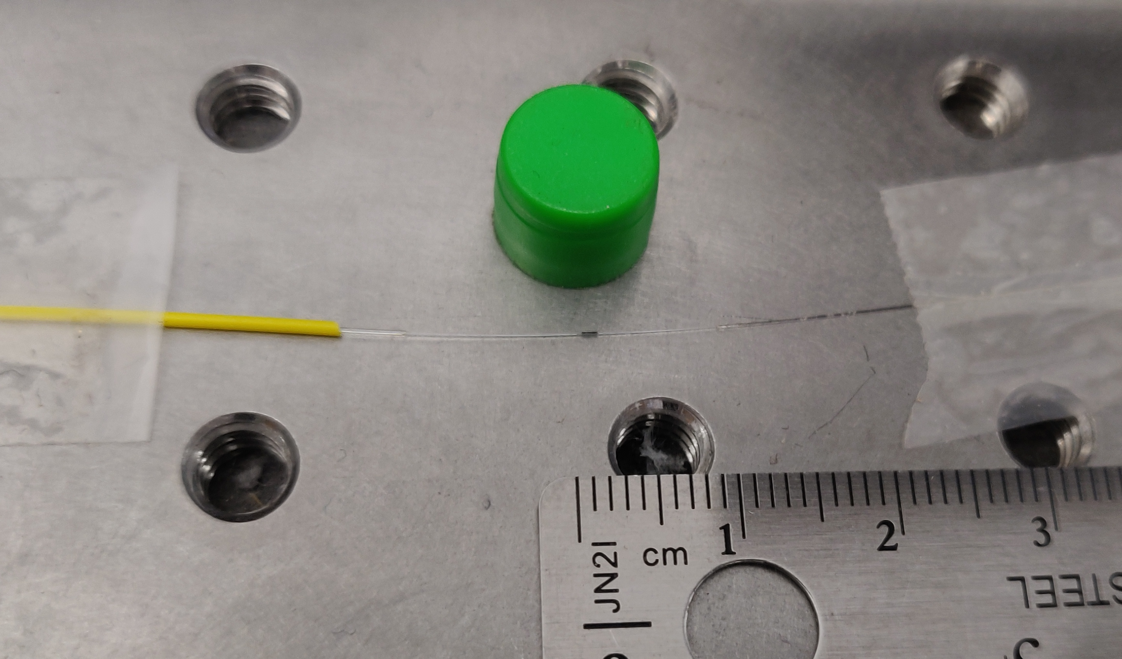
1 mm Germanium-Doped Fiber
$$G_{B}=0.6 W^{−1}m^{−1}$$

Slide 78
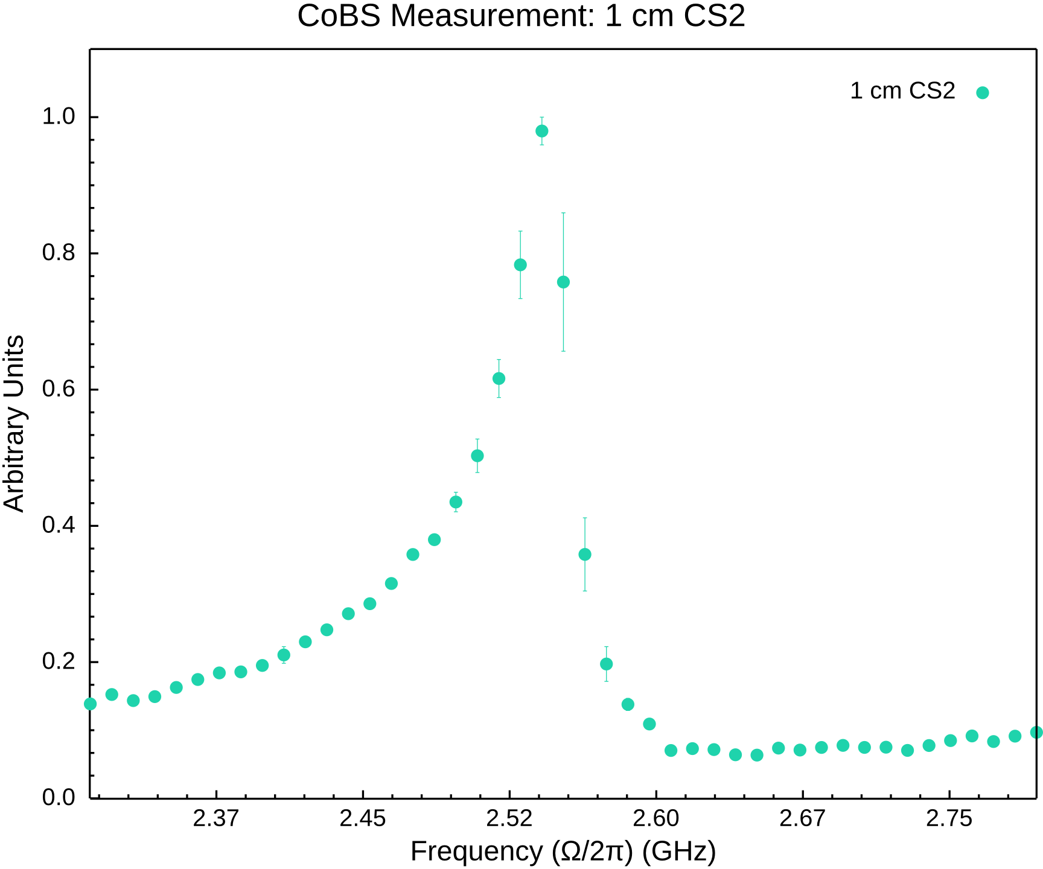
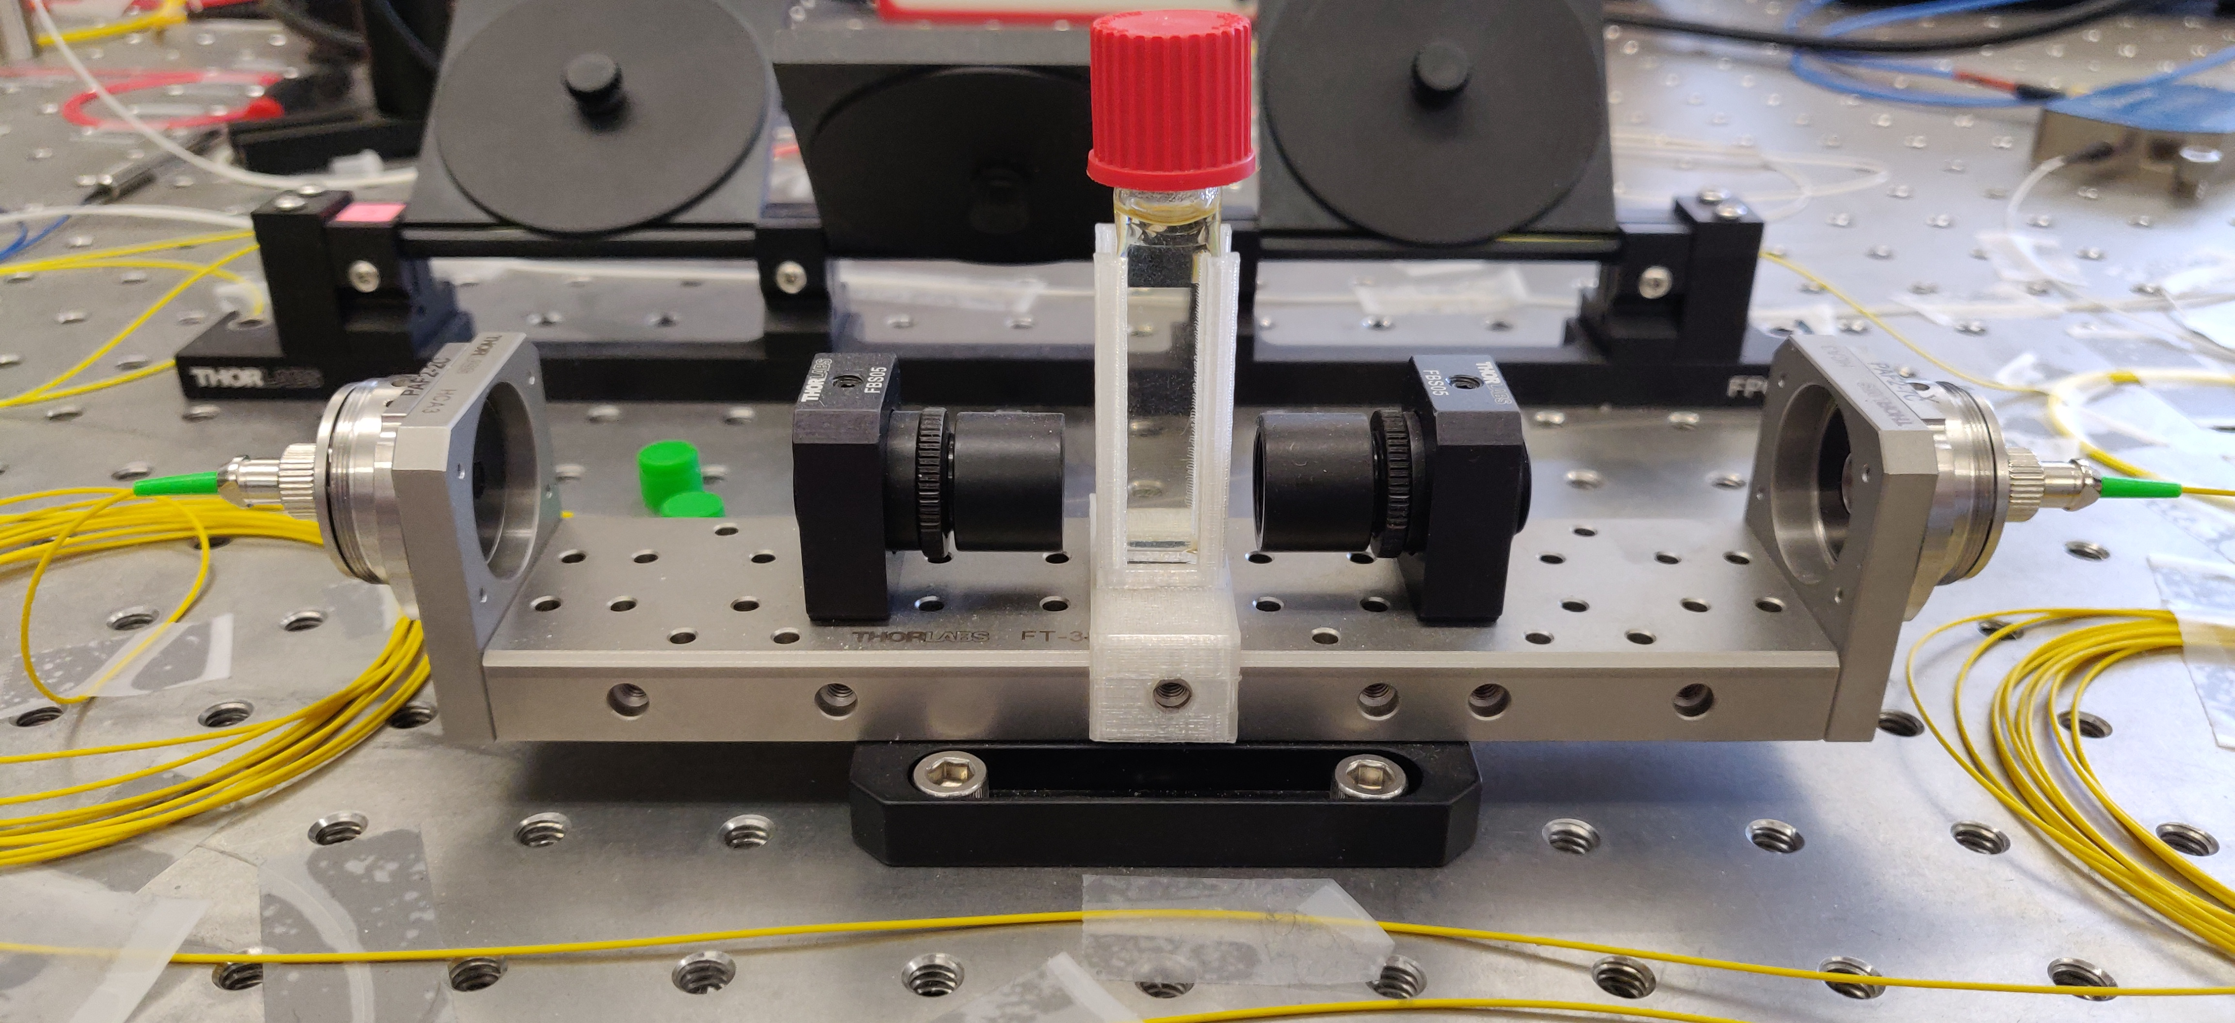
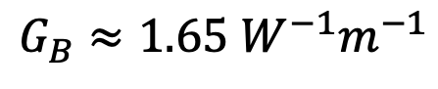
1 cm CS₂
$$G_{B}≈1.65 W^{−1}m^{−1}$$

Slide 79


4 mm CS₂
$$G_{B}≈1.65 W^{−1}m^{−1}$$

Slide 80



1 μm TeO₂
$$G_{B}≈1.1 W^{−1}m^{−1}$$

Slide 81



1 μm TeO₂ Again
5 MHz bins
10 MHz bins
$$G_{B}≈1.1 W^{−1}m^{−1}$$

Slide 82


1 mm CS₂
$$G_{B}≈1.65 W^{−1}m^{−1}$$

Slide 83


100 μm CS₂
$$G_{B}≈1.65 W^{−1}m^{−1}$$

Slide 84


Suspended Silica Chip Waveguide

Slide 85
Controlling Sound with Light
Laser Cooling of Traveling-Wave Phonons in an Optical Fiber
Quieting sound with light

Slide 86
Controlling Sound with Light
Laser Cooling of Traveling-Wave Phonons in an Optical Fiber
Quieting sound with light
Coherently stimulated Brillouin Scattering (CoBS)
Amplifying sound to measure subtle signals

Slide 87
Controlling Sound with Light
Laser Cooling of Traveling-Wave Phonons in an Optical Fiber
Quieting sound with light
Coherently stimulated Brillouin Scattering (CoBS)
Amplifying sound to measure subtle signals
Brillouin-Induced Raman Modes
Harnessing sound for engineered behaviors

Slide 88



Acknowledgements

Slide 89
Optomechanical Heating
Material at room temperature has thermal fluctuations (phonons)
Ω
phonon

Slide 90
Optomechanical Heating
Material at room temperature has thermal fluctuations (phonons)
Laser light
Ω
⍵
phonon

Slide 91
Optomechanical Heating
Material at room temperature has thermal fluctuations (phonons)
Laser light backscatters off retreating sound wave (Brillouin scattering)
Ω
⍵
phonon

Slide 92
Optomechanical Heating
Material at room temperature has thermal fluctuations (phonons)
Laser light backscatters off retreating sound wave (Brillouin scattering)
Energy transfers from light to sound:
Returning light is frequency downshifted (red-shifted)
⍵’ = ⍵ - Ω
Ω
⍵
phonon

Slide 93
Optomechanical Heating
Material at room temperature has thermal fluctuations (phonons)
Laser light backscatters off retreating sound wave (Brillouin scattering)
Energy transfers from light to sound:
Returning light is frequency downshifted (red-shifted)
Sound wave intensity is increased (heated)
⍵’ = ⍵ - Ω
Ω
⍵
phonon

Slide 94
Optomechanical Heating
Material at room temperature has thermal fluctuations (phonons)
Laser light backscatters off retreating sound wave (Brillouin scattering)
Energy transfers from light to sound:
Returning light is frequency downshifted (red-shifted)
Sound wave intensity is increased (heated)
⍵’ = ⍵ - Ω
Ω
⍵
phonon

Slide 95
Optomechanical Heating
Material at room temperature has thermal fluctuations (phonons)
Laser light backscatters off retreating sound wave (Brillouin scattering)
Energy transfers from light to sound:
Returning light is frequency downshifted (red-shifted)
Sound wave intensity is increased (heated)
Stokes
⍵’ = ⍵ - Ω
Ω
⍵
phonon

Slide 96
Optomechanical Heating

Slide 97
Amplitudes: Experiment A

Slide 98
Amplitudes: Experiment A

Slide 99
Amplitudes: Experiment A

Slide 100






LCOF Fabrication

Slide 101
Cooling Experiment B

Slide 102
Cooling Experiment B

Slide 103
Cooling Experiment B

Slide 104
Cooling Experiment B

Slide 105
Cooling Experiment B

Slide 106




Phase Matching Bandwidth
Pump-probe separation
$$P_{sig}=\frac{1}{4}{\left(G_{B}L\right)}^{2}P_{P}P_{S}P_{Pr}sinc^{2}\left(\frac{ΔkL}{2}\right)$$
5 GHz
14.5 GHz
26.5 GHz
37 GHz
$$sinc{\left(x\right)}^{2}$$

Slide 107



Sub-10 fW Sensitivity

Slide 108

P, S, Pr Contribute Equally

Slide 109



Fano Resonance
Interference between the signal and the broad background continuum
Occurs when signal intensity is on the order of the background
Relative phases determine asymmetry

Slide 110



Fano Resonance
$$+q / −q$$
Naïve Lorentzian Fit
Fano Fit

Slide 111



Elastically-Suspended Photonic-Phononic

